Slide 1
CS 117 Winter 12
Lecture 2A, Jan 19, 2012
The 802.11 MAC
TCP
T. 68-71,134-137, 267-270,292-310
Recommended:T.208-211, 462-464, 553-555)

Slide 2
Lecture Outline
1. The wireless channel (mostly covered already in Jan 17 lecture)
Propagation
2. The 802.11 MAC and Wireless LANs
Ref: Tanenbaum Chpt 2, pg 100-107; pg 162-166 (CDMA); pg 292-301
3. TCP:
Basic
Westwood (for wireless links)
TCP in Ad Hoc networks (Ref Tanenbaum 4th edition pg 375-380)

Slide 3
Spectrum and Propagation

Slide 4
EM Spectrum
ISM band
902 – 928 Mhz
S/W radio
FM radio
TV
2.4 – 2.4835 Ghz
AM radio
TV
cellular
5.725 – 5.785 Ghz
LF
MF
HF
VHF
UHF
SHF
EHF
ν
30kHz
300kHz
3MHz
30MHz
300MHz
3GHz
30GHz
300GHz
10cm
100mm
λ
10km
1km
100m
10m
1m
1cm
X rays
ν
infrared
visible
UV
Gamma rays
1 kHz
1 MHz
1 GHz
1 THz
1 PHz
1 EHz
Propagation characteristics are different in each frequency band

Slide 5
Unlicensed Radio Spectrum
λ
33cm
12cm
5cm
26 Mhz
83.5 Mhz
125 Mhz
902 Mhz
2.4 Ghz
5.725 Ghz
928 Mhz
2.4835 Ghz
5.785 Ghz
cordless phones
baby monitors
Wireless LANs (first
generation)
802.11
Bluetooth
ZigBee
etc
Microwave oven
802.11a
This spectrum is free (unlicensed)
However, users must implement “Spread Spectrum”
Techniques in order to minimize mutual interference
DSSS or Frequency Hopping

Slide 6
Mobile Radio Propagation
Free space loss
Two ray model
Slow fading
Fast fading
Delay spread

Slide 7
Radio propagation: path loss
near field
path loss in 2.4 Ghz band
P_{r}
r ≤ 8m
r > 8m
P_{t}
near field
far field
r
∝
r²
∝
r^{3.3}
P_{r}
Two ray (direct + reflected) model
path loss = 10 log (4πr²/λ) r ≤ 8m
= 58.3 + 10 log (r^{3.3} /8) r > 8m

Slide 8
Multipath Fading
Fading: rapid fluctuation of the amplitude of a radio signal over a
short period of time or travel distance
Tx
Rx
Effects of multipath:
Fading
Varying doppler shifts on different multipath signals
Time dispersion (causing inter symbol interference)

Slide 9
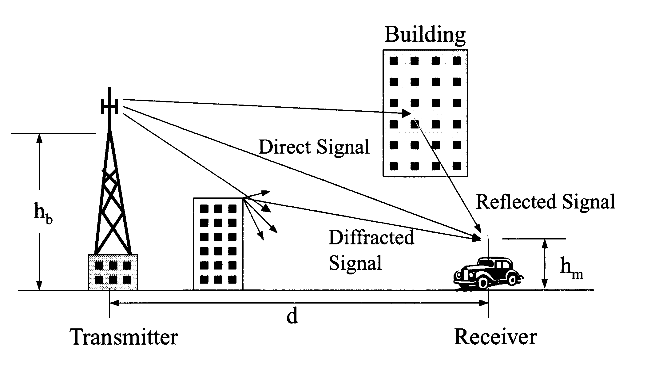
Reflection,diffraction, scattering of radio signals
Scattering

Slide 10
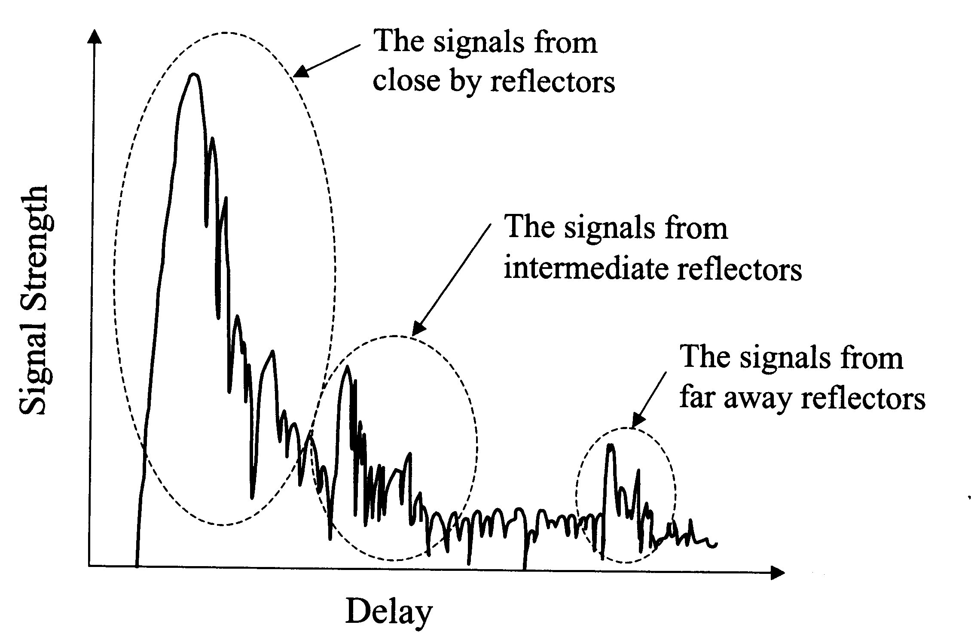
The delay spread of a signal

Slide 11
Propagation mechanisms
Reflection: propagation wave reflected by smooth surface larger than wavelength
Diffraction (shadowing): wave obstructed by surface with sharp, irregular edges.
Scattering: wave hits loose objects smaller than wavelength; signal scattered in bunch of outgoing weaker signals (wavelets)

Slide 12

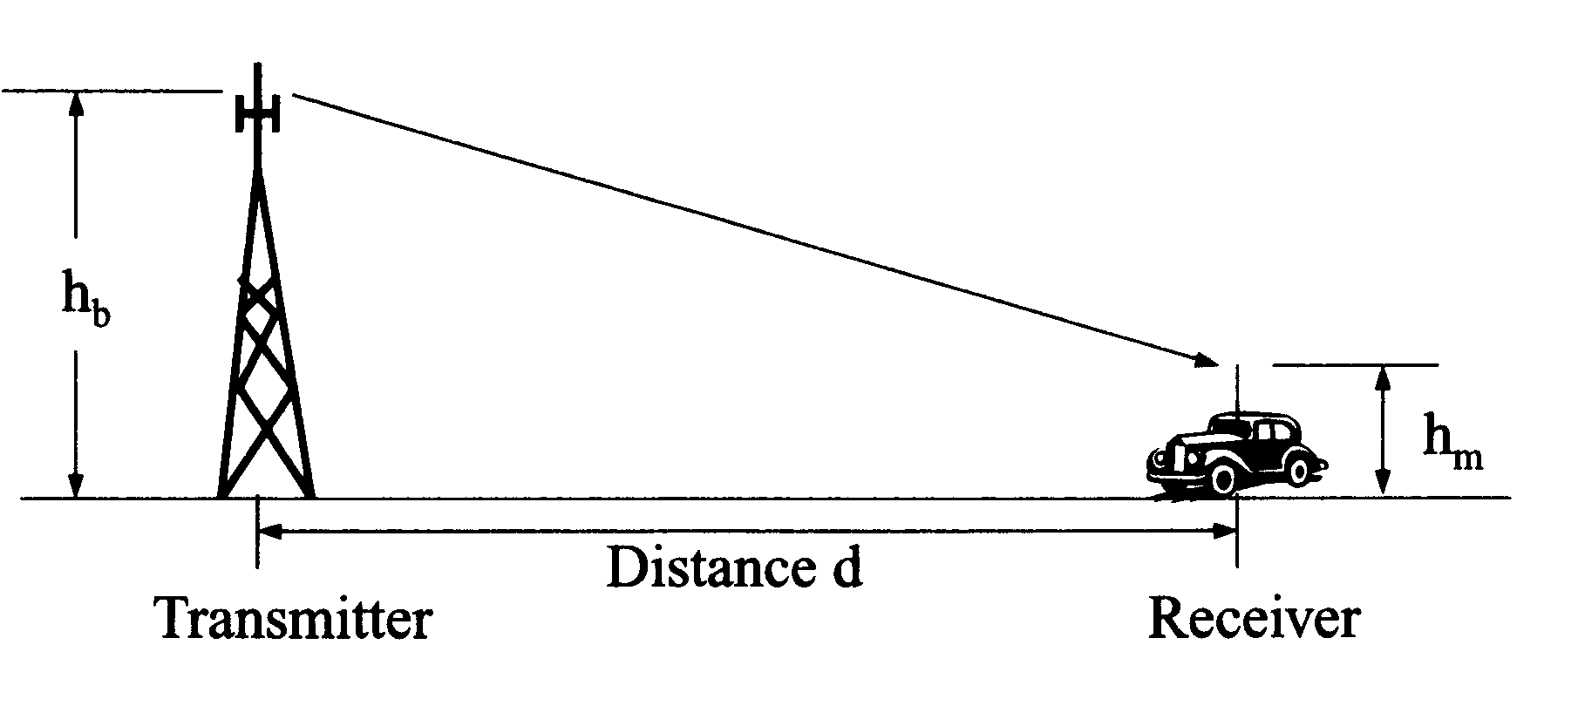
Fading
FAST FADING - observed over traveled distance of about half a . For VHF and UHF, a vehicle traveling 30 mph passes through several fast fades in a sec.
SLOW FADING - caused by large obstructions
Therefore, the mobile radio signal consists of a Short-Term Fast-Fading signal + Long-Term Slow Fading signal, a local mean value that remains constant over a small area and varies slowly as the receiver moves.

Slide 13
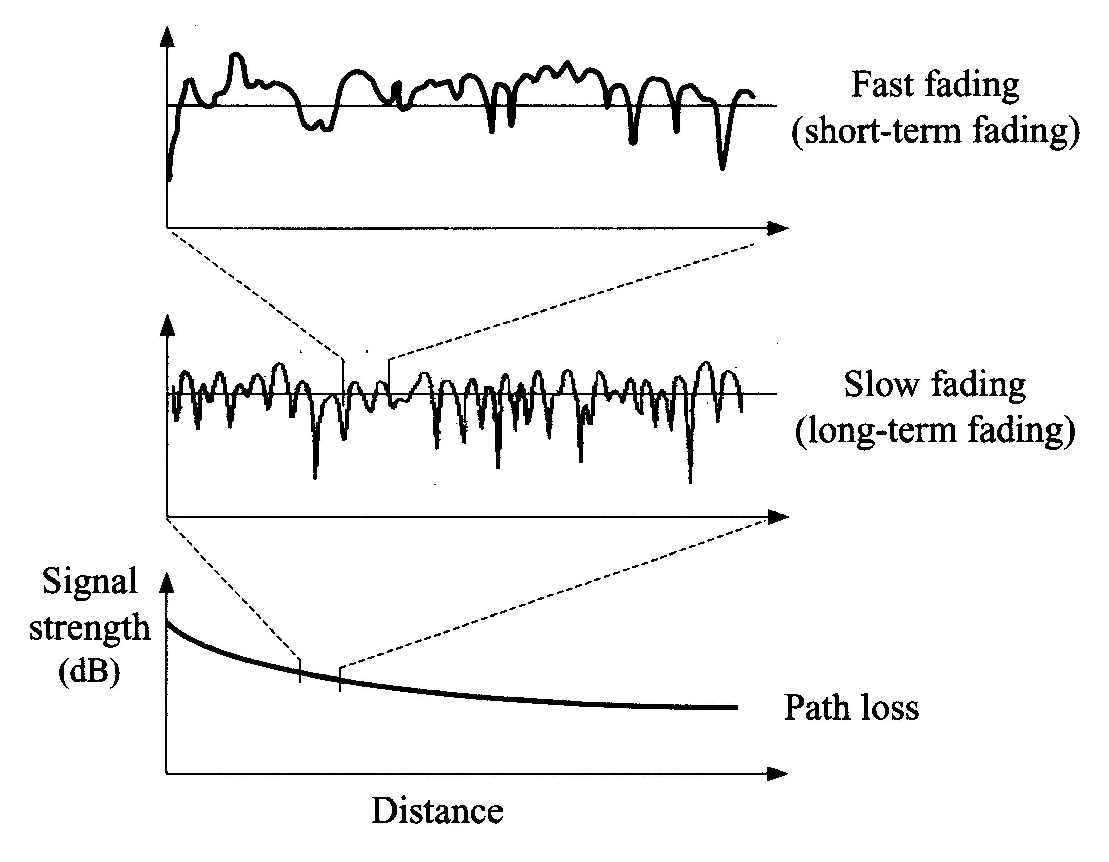

Schematic diagram of propagation loss and fading
Lf = fast fading: rapid fluctuations due to multipath fading
Ls = slow fading (shadow fading): path loss “variation”
caused by changes in landscape, i.e., building.
VHF,
30 mph
In City

Slide 14
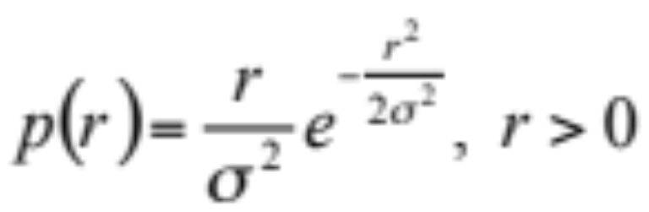
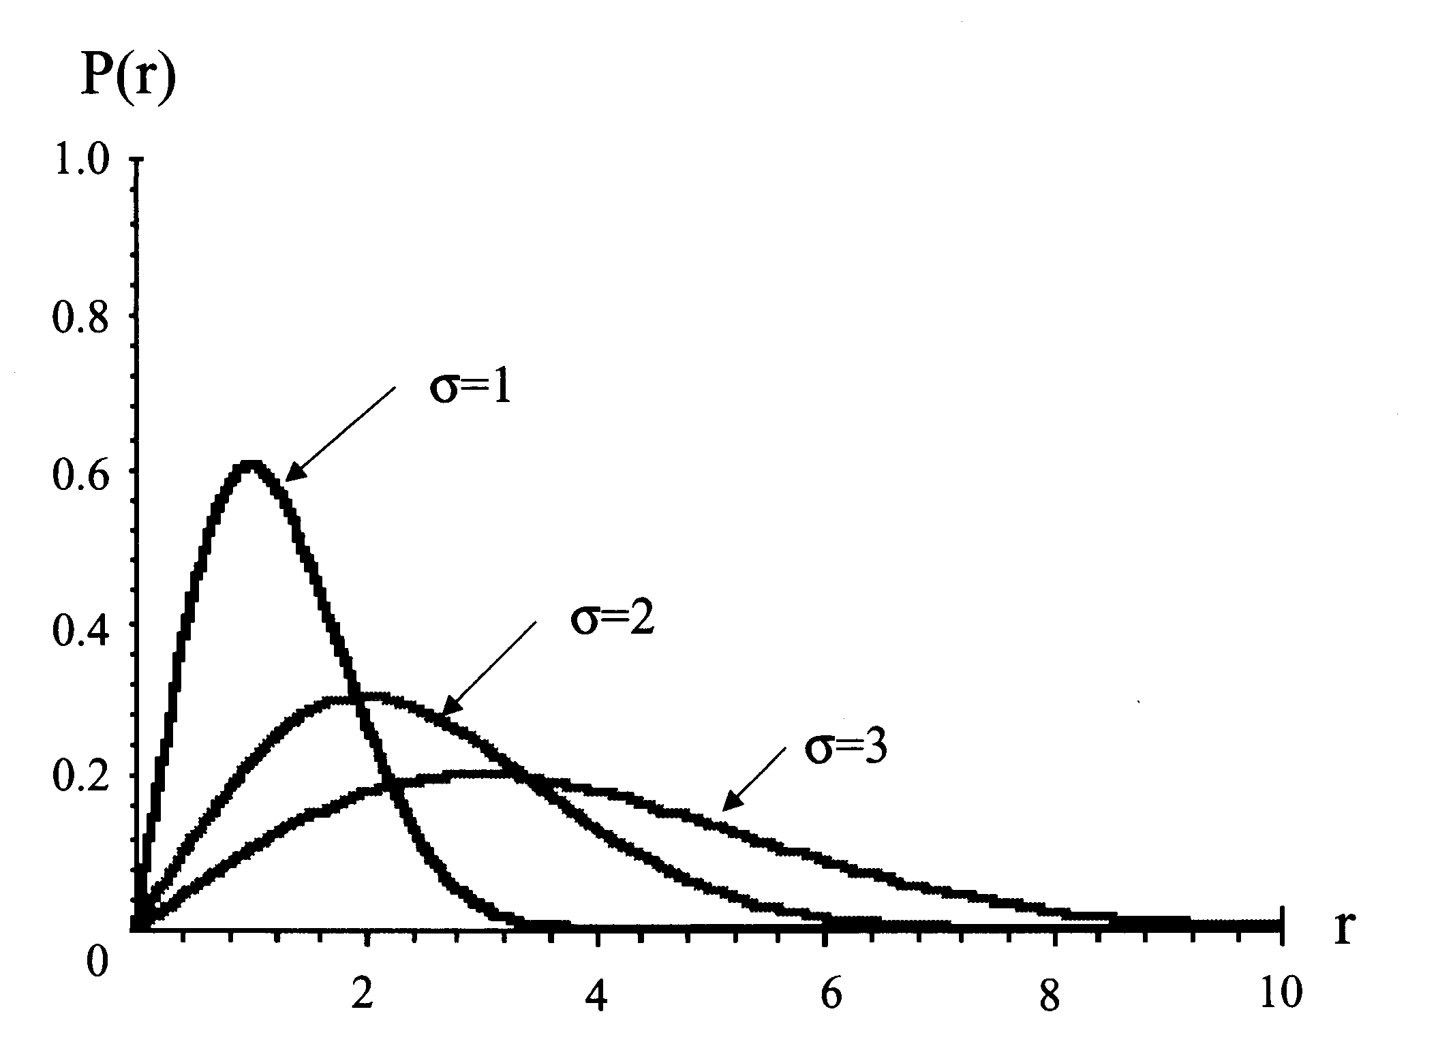

Fast fading: Raleigh distribution
Where r is the envelope of faded signal, is the standard deviation of signal level in decibels.
Probability Density Function of Raleigh distribution when sigma=1,2,and 3

Slide 15
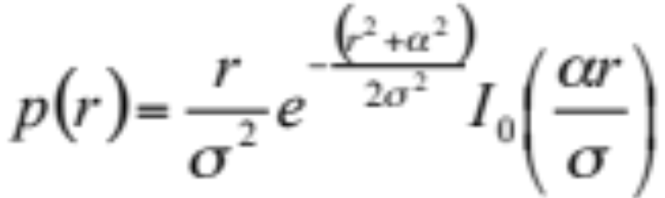
Fast fading: Receiver Close to Transmitter.
In this case, there is a dominant direct “line of sight” ray
We assume that the probability distribution of amplitudes of non dominant signals is Gaussian and their phase has uniform distribution.
Thus, the probability distribution of the envelope of the
composite signal is a Rician distribution:
Rician distribution
Io = zero-order modified Bessel function;
alfa= amplitude of direct signal

Slide 16
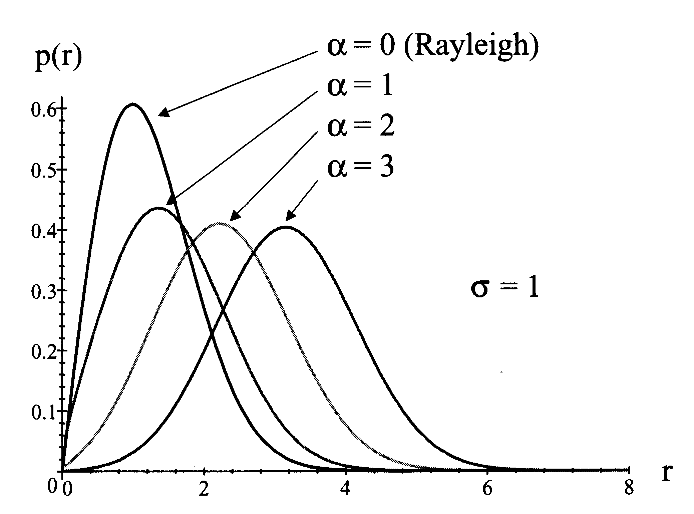
The PDF of envelope of composite signals according to Rician distribution (Fast Fading) alpha = dominant signal/reflected signals

Slide 17
Slow (shadow) fading
Also known as Log-Normal Shadowing - accounts for path attenuation from a remote source (say, several miles away)
Issues: environment may cause significant variations in received
power with distance.
Measurements show that such distribution is log- normal. Why?
Given the large distance d, only one ray arrives at receiver; this
ray was reflected over several surfaces; the total attenuation is
the product of many independent elementary attenuations.
Since: Log of Products = Sum of Logs, the probability distribution of the envelope of the composite signals is a log - Gaussian, ie log -Normal

Slide 18
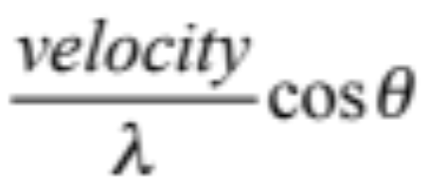

Doppler effect
Envelope of composite signals also depends on Doppler’s Effect (when a wave source and a receiver are moving relative to one another, the frequency of the received signal will not be the same as the source).
Receiver mobility affects the received frequency Fr:
Fr = Ft - FDoppler
Fd =
Where =angular difference between speed and T-R axis

Slide 19
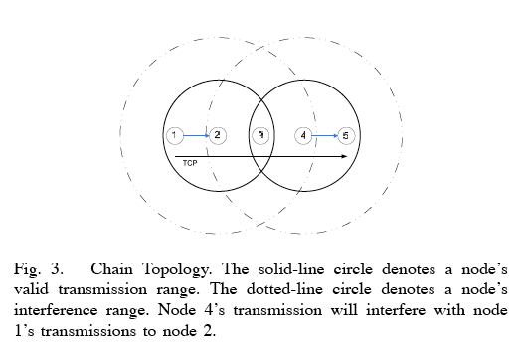
Tx, Sense, Interfence Range

Slide 20
Wireless LANs - MAC layer
MAC Protocols Review
The 802.11 Physical Layer
IEEE 802.11 MAC

Slide 21
MAC Layer
Media Access Control protocol: coordination and scheduling of transmissions among competing neighbors
Goals: low latency, good channel utilization; best effort + real time support
MAC layer clustering: aggregation of nodes in a cluster (= cell) for MAC enhancement

Slide 22
MAC protocols reviewed
FDMA/TDMA/CDMA
ALOHA
CSMA (Packet Radio Net)
IEEE 802.11
Bluetooth
ZigBee

Slide 23
TDMA
Time Division Multiple Access
  Time frame divided in slots: one slot per user
Problem with TDMA?
frame
…..

Slide 24
Frequency Hopping (FH)
Frequency spectrum sliced into frequency subbands (eg, 125 subbands in a 25 Mhz range)
Time is subdivided into slots; each slot can typically carry one packet (or fraction of it)
A Bluetooth packet covers up to 5 freq slots
Users are clock and slot synchronized; they frequency hop slot by slot according to unique, predefined sequence;
Ideally, hopping sequences are “orthogonal” across networks (ie, no overlap); in practice, conflicts occur

Slide 25
Bluetooth Frequency Hopping:
1pkt per frequency slot
f1
f2
f3
f4
f5
f6
m
s1
s2
625 µsec
1600 hops/sec

Slide 26
MAC protocols
(a) Channel Partitioning : TDMA, FDMA,
(b) Random Access: CSMA, MACA NEXT
(c) “Taking turns” : polling

Slide 27
Random Access protocols
A node transmits at random (ie, no a priory coordination among nodes) at full channel data rate R.
If two or more nodes “collide”, they retransmit at random times
The random access MAC protocol specifies how to detect collisions and how to recover from them (eg, retx)
Examples:
(a) SLOTTED ALOHA
(b) ALOHA
(c) CSMA and CSMA/CD

Slide 28

Slotted Aloha
Time is slotted (slot = full packet size)
a newly arriving station transmits at the beginning of the next slot
if collision occurs (assume channel feedback) the source retransmits the packet at each slot with probability P, until successful.
Success (S), Collision (C), Empty (E) slots
Throughput efficiency = 1/e

Slide 29
CSMA (Carrier Sense Multiple Access)
CSMA: listen before transmit. If channel is sensed busy, defer transmission
Persistent CSMA: retry immediately when channel becomes idle (this may cause instability)
Non persistent CSMA: retry after random interval
Note: collisions may still exist:
  two stations may sense the channel idle at same time
  In case of collision, the entire pkt is retransmitted

Slide 30

CSMA collisions

Slide 31
CSMA/CD (Collision Detection)
CSMA/CD: carrier sensing like in CSMA. Now, collisions are detected within a few bit times.
  Transmission is then aborted, reducing channel OH, wastage
  Typically, persistent transmission is implemented
  CSMA/CD can approach channel utilization =1 in LANs (low ratio of propagation over packet transmission time)
Collision detection is easy in wired LANs (eg, E-net): can measure signal strength on the line, or code violations, or compare tx and receive signals
Collision detection cannot be done in wireless LANs (the receiver is shut off while transmitting, to avoid damaging it with excess power)

Slide 32

802.11 Wireless LAN Configurations
1. Ad-Hoc Networking 2. Infrastructure Networking
BS
Standard IEEE committee work in mid 1990,
Goal: send IP packets over the WLAN, and make 802.11 compatible with Ethernet above the DLL.

Slide 33
802.11 - MAC layer
Access methods
  MAC-DCF CSMA/CA (mandatory)
    Physical channel sensing
    collision avoidance via randomized „back-off“ mechanism
    minimum distance between consecutive packets
    ACK packet (not for broadcasts)
  MAC-DCF w/ RTS/CTS (optional)
    Physical AND Virtual channel sensing
    Distributed Foundation Wireless MAC
    avoids hidden terminal problem
  MAC- PCF (optional)
    access point polls terminals according to a list

Slide 34
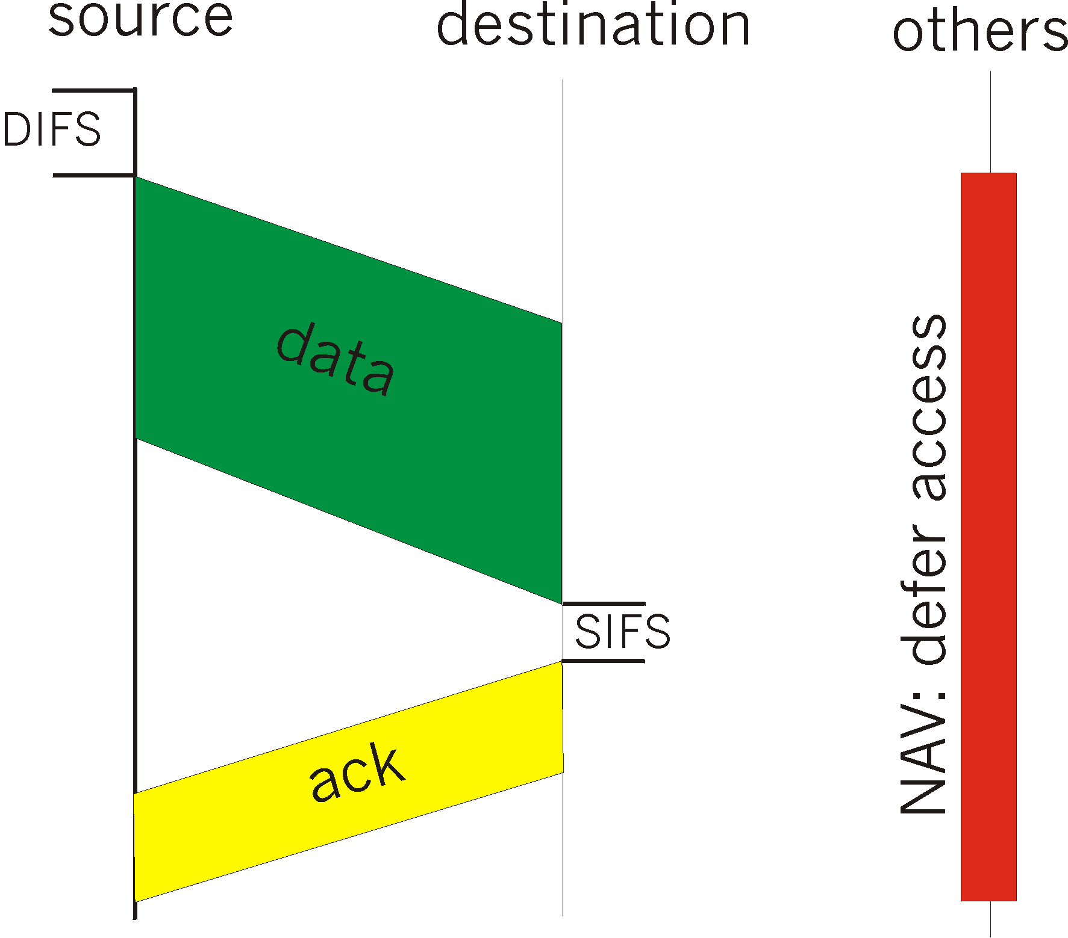
IEEE 802.11 Medium Access
CSMA Version of the Protocol:
sense channel idle for DIFS sec (Distributed Inter Frame Space)
transmit frame (no Collision Detection)
receiver returns ACK after SIFS (Short Inter Frame Space)
if channel sensed busy => binary backoff (like Ethernet)
NAV: Network Allocation Vector (min time of deferral)

Slide 35
802.11 - CSMA/CA access method
contention window
(randomized back-off
mechanism)
DIFS
DIFS
medium busy
next frame
direct access if
medium is free ≥ DIFS
t
slot time
  station ready to send starts sensing the medium (Carrier Sense based on CCA, Clear Channel Assessment)
  if the medium is free for the duration of an Inter-Frame Space (DIFS), the station can start sending
  if the medium is busy, the station has to wait for a free DIFS, then the station must additionally wait a random back-off time (collision avoidance, multiple of slot-time)
  if another station occupies the medium during the back-off time of the station, the back-off timer stops (fairness)
Notes:
12

Slide 36
802.11 - CSMA/CA (cont)
Sending unicast packets
  station has to wait for DIFS before sending data
  receivers acknowledge at once (after waiting for SIFS) if the packet was received correctly (CRC)
  automatic retransmission of data packets in case of transmission errors
DIFS
data
sender
SIFS
ACK
receiver
DIFS
other
stations
data
t
waiting time
contention

Slide 37
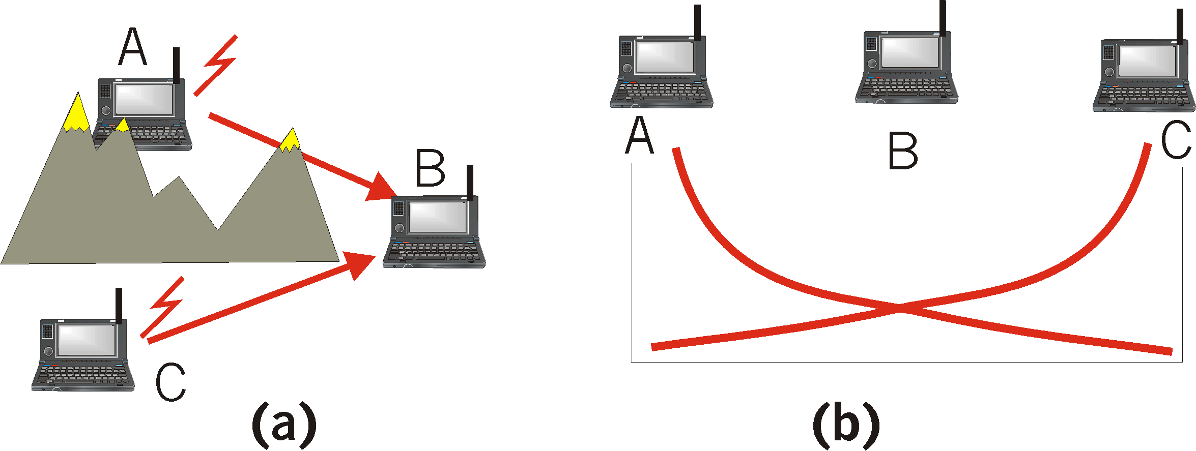
Hidden Terminal effect
CSMA inefficient in presence of hidden terminals
Hidden terminals: A and C cannot hear each other because of obstacles or signal attenuation; so, their packets collide at B

Slide 38
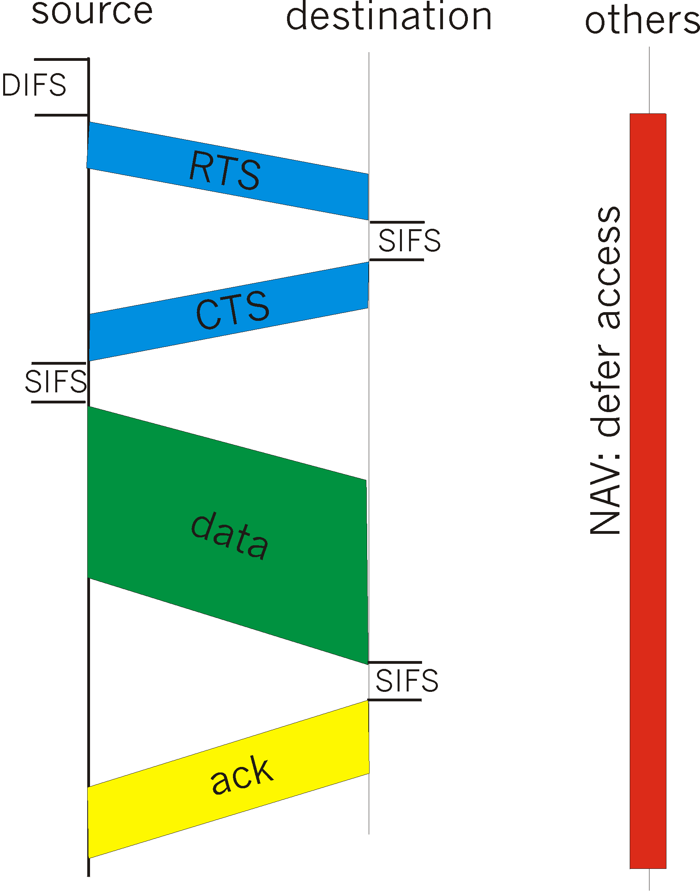
Virtual Channel Sensing (RTS/CTS)
CTS “freezes” stations within range of receiver (but possibly hidden from transmitter); this prevents collisions by hidden station during data
RTS and CTS are very short: collisions during data phase are thus very unlikely (similar effect as Collision Detection)
“Virtual” channel sensing as opposed to physical sensing

Slide 39
The RTS/CTS solution (CSMA/CA+RTS/CTS)
C
A
RTS
B
D
C
A
CTS
B
D
E
E
A sending an RTS to B; B responding with a CTS to A.
After CTS is received, A begins transmission
Anyone hearing RTS must remain silent until CTS is transmitted back to A. Anyone hearing CTS must remain silent during the upcoming data transmission, whose duration t is declared in the CTS header.

Slide 40
802.11 - CSMA/CA + RTS/CTS
Sending unicast packets
  station can send RTS with reservation parameter after waiting for DIFS (reservation declares amount of time the data packet needs the medium for)
  acknowledgement via CTS after SIFS by receiver (if ready to receive)
  sender can now send data at once, acknowledgement via ACK
  other stations store medium reservations announced by RTS and CTS
DIFS
RTS
data
sender
SIFS
SIFS
SIFS
CTS
ACK
receiver
NAV (RTS)
DIFS
other
stations
data
NAV (CTS)
t
defer access
contention

Slide 41
MAC-PCF (Point Coordination Function) like polling
t₀
t₁
SuperFrame
medium busy
PIFS
SIFS
SIFS
D₁
D₂
point
coordinator
SIFS
SIFS
U₁
U₂
wireless
stations
stations‘
NAV
NAV

Slide 42
MAC-PCF (cont)
t₂
t₃
t₄
PIFS
SIFS
D₃
D₄
CF_{end}
point
coordinator
SIFS
U₄
wireless
stations
stations‘
NAV
NAV
contention free period
contention
period
t

Slide 43
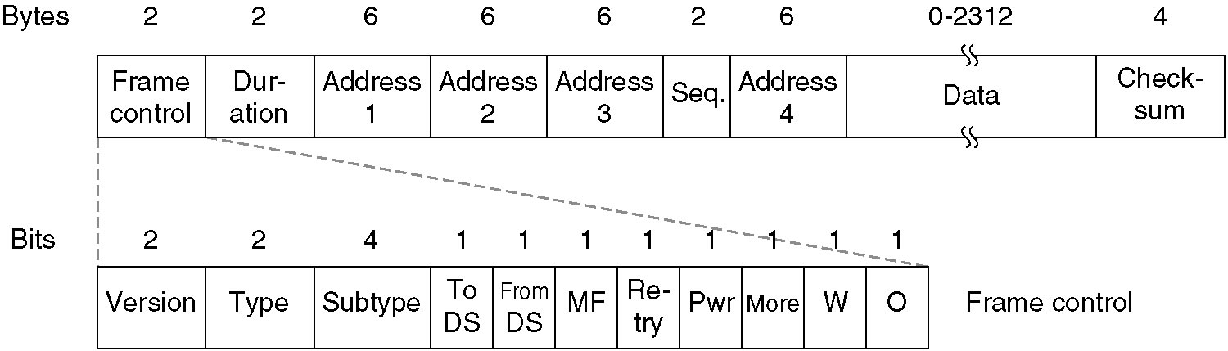
The 802.11 Frame Structure
1. data frame
MAC Header

Slide 44
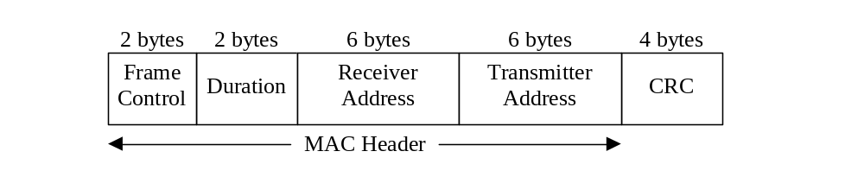
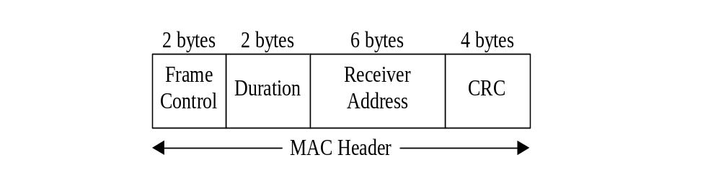
802.11 Frame Structure (cont)
2. Control frame= RTS, CTS, ACK
RTS
CTS
ACK
3. Management Frames
Exchange management information and are transmitted in the same manner as data frames, but are not forwarded to upper layer.
These frames are used for synchronization, authentication, and power management.

Slide 45
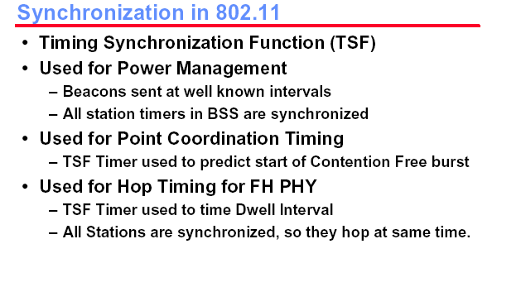

Slide 46
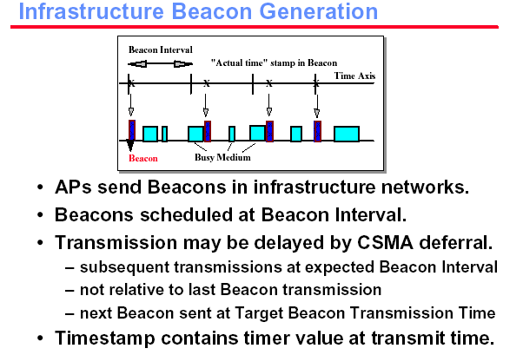

Slide 47
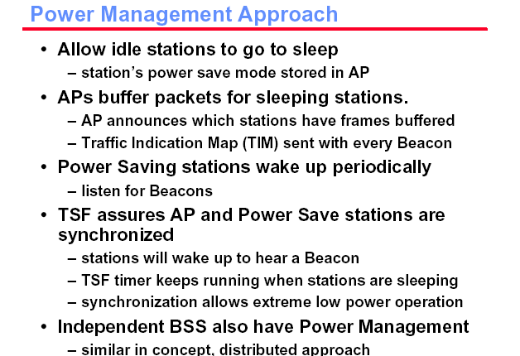

Slide 48
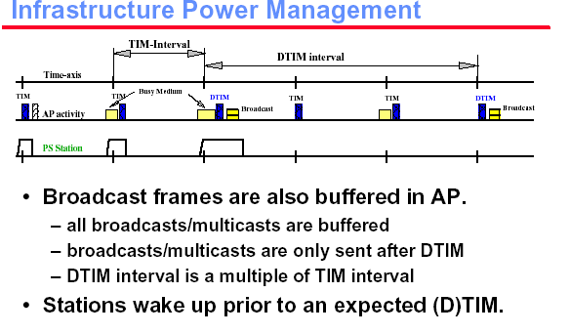

Slide 49
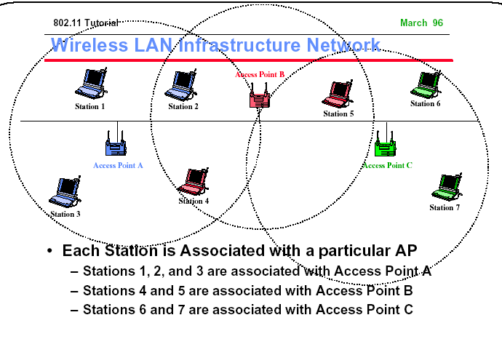

Slide 50
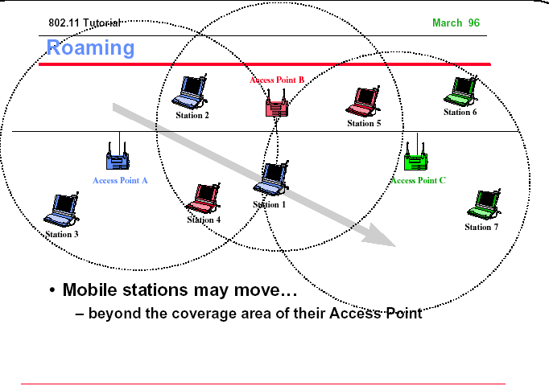

Slide 51
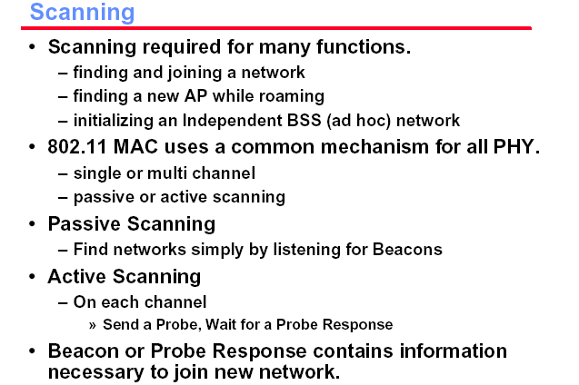

Slide 52
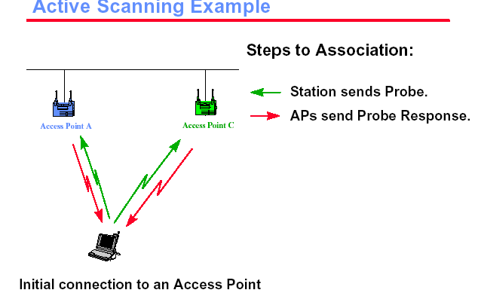

Slide 53
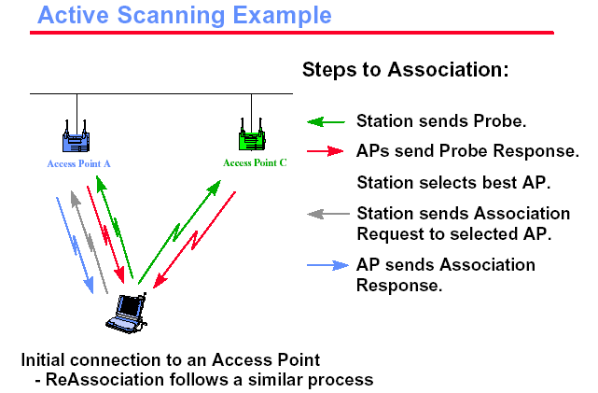

Slide 54
Higher Speeds?
IEEE 802.11a
  compatible MAC, but now 5.8 GHz ISM band
  transmission rates up to 54 Mbit/s
  OFDM modulation scheme
  close cooperation with BRAN (ETSI Broadband Radio Access Network)
IEEE 802.11g
  OFDM modulation
  Operates in the 2.4 Ghz (like 802.11b)
  Up to 54Mbit/s

Slide 55
Better QoS guarantees?
QoS guarantees desirable for real time traffic
IEEE 802.11 e is the answer
EDCF mode (Enhanced DFC):
  Traffic class dependent CWmin and DIFS
  Frame bursting: RTS-CTS-DATA-ACK-DATA-ACK-DATA-ACK…..
HCF mode (Hybrid Coordination Function):
  Similar to the PCF of 802.11b
  Alternation of CP (contention periods) and CFP (cont free periods)
  During the contention period EDCF mode is enacted, except that the AP can issue a QoS poll to specific stations (using PIFS)
  High priority stations can tell the AP about their needs (to get the Poll)
Clearly, the Best Effort traffic is second citizen in this case!
Another challenge is the coexistence of 802.11b and e

Slide 56
CSMA/CA Protocol: congestion control

Slide 57
Congestion Avoidance: in IEEE 802.11 DCF
Before transmitting a packet, randomly choose a backoff interval in the range [0,cw]
  cw is the contention window
“Count down” the backoff interval when medium is idle
  Count-down is suspended if medium becomes busy
When backoff interval reaches 0, transmit packet (or RTS)

Slide 58
DCF Example
Let cw = 31
B1 = 25
B1 = 5
wait
data
data
wait
B2 = 20
B2 = 15
B2 = 10
B1 and B2 are backoff intervals
at nodes 1 and 2

Slide 59
Congestion Avoidance
The time spent counting down backoff intervals contributes to MAC overhead
Choosing a large cw leads to large backoff intervals and can result in larger overhead
Choosing a small cw leads to a larger number of collisions (more likely that two nodes count down to 0 simultaneously)

Slide 60
Congestion Control
Since the number of nodes attempting to transmit simultaneously may change with time, some mechanism to manage congestion is needed
IEEE 802.11 DCF: Congestion control achieved by dynamically adjusting contention window cw

Slide 61
Binary Exponential Backoff in DCF
When a node fails to receive CTS in response to its RTS, it increases the contention window
  cw is doubled (up to an upper bound – typically 5 times)
When a node successfully completes a data transfer, it restores cw to CWmin

